Slide 1
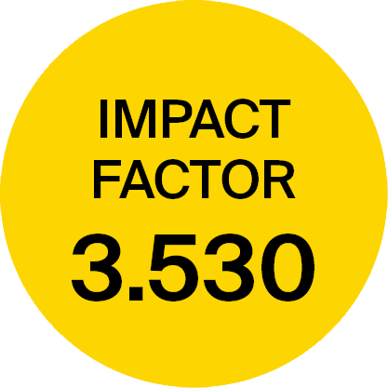
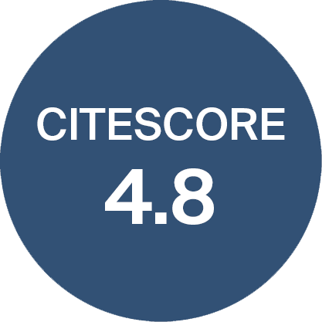
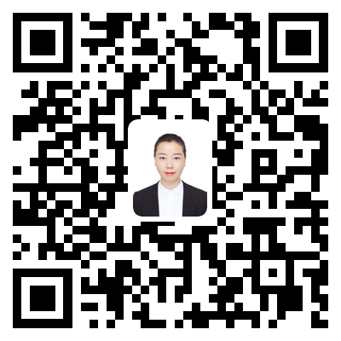
Aim and Scope:
3.530 Impact Factor
41 days Median Processing Time
Water (ISSN 2073-4441) is an international and interdisciplinary open-access journal covering all aspects of water. There is no restriction on the length of the papers.
Water Management and Governance
Hydrology & Hydraulics, Water Scarcity, Flood Risk & Water Quality
Water & Wastewater Treatment
Urban Water Management
Water Footprint Assessment
Water in relation to Food, Energy & Human Development
Water and Ecosystems
17 days Submission to First Decision
3 days Acceptance to publication
WeChat of Assistant Editor

Slide 2
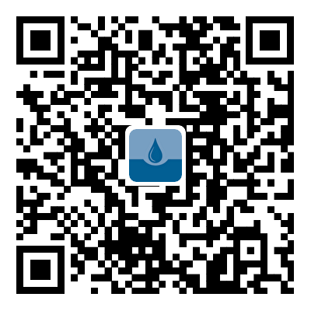
Advances in Desalination and Wastewater Treatment
Special Issue Editor
Submissions Deadline: 31 October 2023
Prof. Dr. J. Jaime Sadhwani Alonso
University of Las Palmas de Gran Canaria, Spain
jimmy.sadhwani@ulpgc.es
Topics to be addressed include but are not limited to the following:
Wastewater regeneration;
Water–energy nexus;
Elimination of emerging pollutants with membrane technologies;
Advanced membrane process technologies;
Minimization of environmental problems.
Dr. Jenifer Vaswani Reboso
University of Las Palmas de Gran Canaria, Spain
jenifer.vaswani@ulpgc.es
Special Issue Editors or catherina.xing@mdpi.com
Scan the QR code to the Special Issue website.

